Slide 1
Heart Disease Diagnostic Analysis

Slide 2
Introduction
The Heart Disease Diagnostic Analysis project aims to harness the power of Tableau, a leading data visualization platform, to gain comprehensive insights into the factors influencing heart disease. By analyzing various datasets, including patient records, clinical trials, and public health data, we seek to uncover critical risk factors such as age, cholesterol levels, blood pressure, and lifestyle habits. This project will utilize advanced visualization techniques to identify patterns and correlations, providing a deeper understanding of heart disease prevalence and its underlying causes.
By conducting thorough analyses, we seek to understand the risk factors, symptoms, and diagnostic criteria associated with heart disease, enabling data-driven decision-making in patient assessment, treatment planning, and preventative care. The insights gained from this project will support healthcare professionals in making informed decisions, improving diagnostic accuracy, and developing effective prevention strategies. Ultimately, our goal is to enhance patient outcomes and contribute to the broader effort of combating heart disease through evidence-based practices and innovative data analysis.

Slide 3
Details of Data
Demographic Information
Patient ID
Age
Gender
Ethnicity
Medical History
Family History of Heart Disease
Previous Medical Conditions
Current Medications
Lifestyle Factors
Smoking Status
Alcohol Consumption
Physical Activity Level
Dietary Habits
Clinical Measurements
Blood Pressure
Cholesterol Levels (LDL, HDL, Total)
Blood Glucose Levels
Body Mass Index (BMI)

Slide 4
Main KPI’s
Age
Sex name
Population count by gender
Heart disease by chest pain
St depression
Cholestrol vs sex name

Slide 5
Details of Dashboard
1 Population Count by Gender:
Majority of the population is male (206).
2 Heart Disease by Chest Pain Type:
Asymptomatic chest pain type has the highest count of individuals with heart disease (21).
3 Chest Pain Based on Age Category:
Most common chest pain type in the elder age group is asymptomatic (89).
4 Age Group Count:
The largest age group is Elder (160).
5 ST Depression vs Age:
ST depression shows significant variation across different ages.
6 Cholesterol vs Sex Name:
Average cholesterol levels are similar for both males and females across different ages.
.

Slide 6
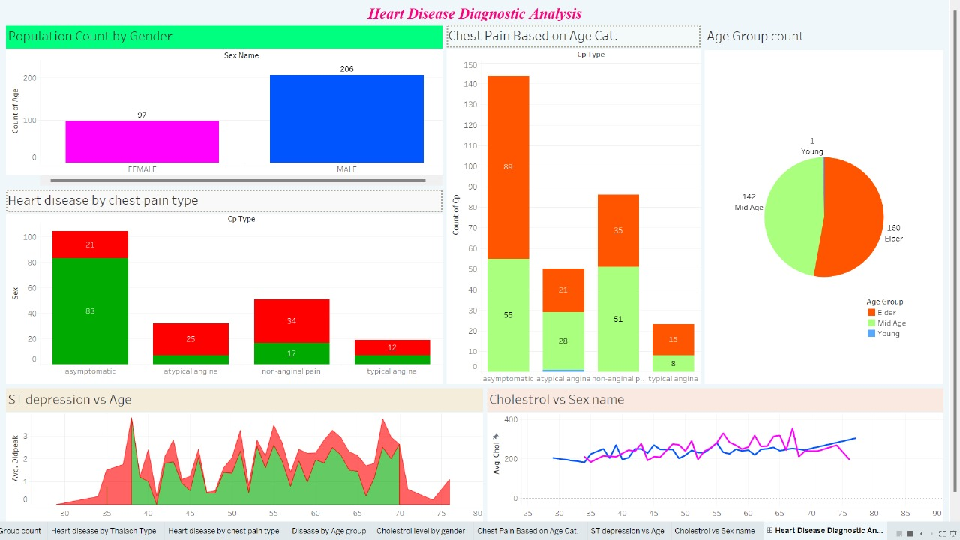
My Design

Slide 7
Thank you!

